Slide 1
For information about membership opportunities, please contact:
Larry Clinton
President & CEO
lclinton@isalliance.org
(703) 907-7028
For more information about the Internet Security Alliance, please visit www.isalliance.org

Slide 2
ISA 2001-2026
Picture of 25th anniversary logo
Also we need to discusss getting video of all board attendees with congrats to ISA messager

Slide 3
ISA MISSION AND GOALS
MISSION: To integrate advanced technology with economics and public policy to create a sustained system of cyber security
GOALS
To provide thorough leadership on cybersecurity for government and industry
To advocate for effective cybersecurity public policy
To promote the use of effective standards, practices and technology for cybersecurity
To keep the ISA, as an institution, strong

Slide 4
ISA HISTORY AWARDS
Septate slide for 4 Corporate 100 awards
Septate slide for 4 Four Reed Awards
Septate slide for 4 Challenge Medal
Septate slide for 4 Choice

Slide 5

ISA THOUGHT LEADERSHIP & POLICY

Slide 6

ISA-NACD CYBER RISK HANDBOOK --2026

Slide 7

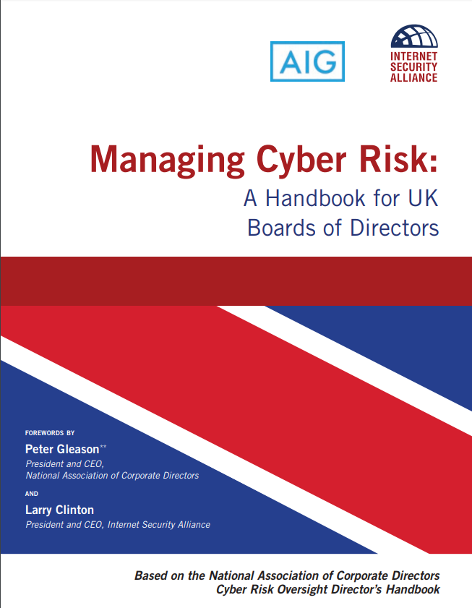
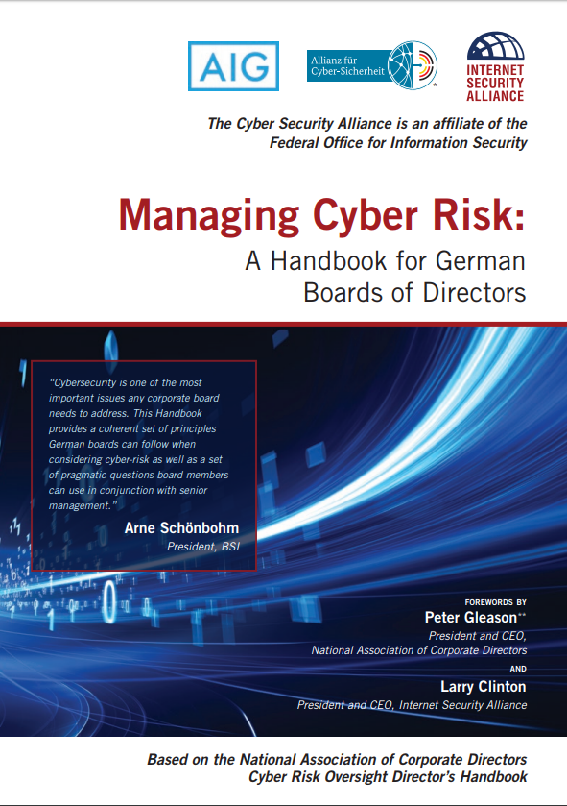
ISA Board of Directors Cyber Risk Handbooks – U.S., UK, Germany, Europe, Latin America and Japan

Slide 8



ISA Board of Directors Cyber Risk Handbooks – U.S., UK, Germany, Europe, Latin America and Japan

Slide 9
ISA PUBLICATIONS
Cybersecurity for Business
Earlier Social /contract books

Slide 10
ISA PARTNERSHIPS

Slide 11
GOALS FOR SPRING 2026 BOARD MEETING
RECENT WORK ON ENTERPRISE RISK MANGEMTN WITH NACD – AND FUTUTRE US OR INTERNATIONAL ENGAGEMENT
PUBLIC POLICY INTIATIVES – ISA’S ZERO COST PLAN TO ENHANCE CYBERSECUITY
DEVELOPING A NEW ISA THREE YEAR PLAN BUILDING ON SOCIAL CONTRACT AND AI, QUANTUM WKFORCE AND OTHER ISSUES

Slide 12
2025- BD EVALUATION & FIVE-YEAR AVERAGE
2025 5 YEAR
ISA GOAL #1 PROMOTING THOUGHT LEADERSHIP
MODE SCORE 5.0 5.0
MEAN SCORE 4.79 4.8
ISA GOAL #2 ADVOCATING FOR PUBLIC POLICY
MODE SCORE 5.0 5.0
MEAN SCORE 4.88 4.8
ISA GOAL #3 PROMOTING BEST PRACTICES
MODE SCORE 5 .0 5.0
MEAN SCORE 5.0 4.9
ISA GOAL #4 KEEPING ISA STRONG
MODE SCORE5 3.0 4.3
MEAN SCORE 4.2 4.3

Slide 13
COMMENTS THOUGHT LEADERSHIP
“A key strength, bringing the board in as our secret sauce
Defiantly a 5 -- all the aspects
Our work gets to the highest levels.
Based on comparison with other associations – ISA is a 10 on thought leadership by far more successful than other organizations we are in
we are focused on what moves the needle

Slide 14
THOUGHT LEADERSHIP
Look at the attention we get from the Congress—that is a big signal -- in tune with the right topics
Very impressed identifying where we can make progress e.g. duplicative regulation
Great picking up on the Trump Administration
Couldn’t find a way to do better
Really good connections with WEF/EU
The TL is why I’m part of the ISA.

Slide 15
THOUGHT LEADERSHIP
Excellent, more could be done with more people
WE need to revisit some of our goals
We need to look at how we anchor in the book and come up with a top 10 list
Are people listening to our TL? What does success look like – the NACD success is the test
We need to expand the network exposed to ISA. ISA’s is better than everyone else

Slide 16
POLICY ADVOCACY
I don’t know of another organization that does this as well as ISA.
Our GR team is always impressed with the meetings we get regularly
A great job, not just the meetings but the books and the blogs
Everything take together it’s all excellent, but we don’t want to be picking sides as the majority may flit in 27
others just are dabbling in policy they don’t have the steady dedicated effort as at ISA
Hard to say how it could be better – don’t change!

Slide 17
POLICY ADVOCACY
Compared to other organizations we are in this is a 5 or whatever is the highest rank I can give –
Don’t know what else you can do
Salon dinners are great
ISA really makes a difference. Great team
I talk to other CISOs, and they don’t have the same opportunits ISA provides. WE are at the table, not the “policy person”

Slide 18
POLICY ADVOCACY
I gave is a 4.9. Its t would be a 5 but we need more balance
Need to be more flexible with priorities – we need to be able to recalibrate
We need to reform the website.
How to get experts to dig deeper. Are there approaches beyond the board meetings?
Maybe more on Executive side targeting the Administration

Slide 19
BEST PRACTICES
Biggest feather in the ISA cap is work with the NACD, and directors see that ISA is the source – worth the price of admission
High marks for the rigor in explaining the economic model for cybersecurity
We can see the impact of the handbook—it gets the boards to ask the right questions
Global desire to work with the ISA—is testament to the excellent work we do—especially the edited versions for EU/Germany and Japan

Slide 20
BEST PRACTICES
The gold standard for ISA. Makes ISA unique cause it’s not just technical
Excellent! NACD is why we are involved
Handbook is key for us. We use it in our work with partners. Our work gets to the highest levels.
ISA has been the trailblazer. Once CS was a novelty for the board and now it’s a central issue –ISA has a lot to do with that

Slide 21
BEST PRACTICES
There is a cost to participate as it requires time but it’s worth the reward
Are we getting feedback, we need handbook stats to calibrate the impact
The challenge is the pace—we do a great job but hard to keep up to meet the challenge—maybe we can give constant updates via AI
Need a more coordinated promotion program – maybe with 1631 Digital

Slide 22
KEEPING ISA STRONG
Keep going and follow the plan – NACD will help
We are focused on the right things – we need to work on continuity
Good addition of new talent
Like the monthly reports
There really is nothing like ISA—although others have elements of it – I prefer a smaller group like ISA. Very proud to be part of it

Slide 23
KEEPING ISA STRONG
More concerned about this than ever before – we need to close on some new members
This is the area where we have the most work to do. Clearly the landscape has changed
Need to figure out how to recruit – brainstorming at the board meeting
Need to justify based on what ISA provides and people can’t get elsewhere – like policy changes

Slide 24
KEEPING ISA STRONG
This is not a typical board – different model, –other boards have –narrower scope
Maybe the board should break up into groups of 3 and report back to the board
How do we get people to commit the time? It’s a competition for mind-space
We split costs between two levels – board should develop best practices for how to get dues approved –how are we selling ISA?

Slide 25
2026 NACD HANDBOOK
2026 COVER SHOT
COVER SHOT OF AI SUPPLEMENT
LIST PRNCIPLES AND THEN TOOL KIT CHAPTERS (W/AUTHORS)

Slide 26
Promotional Campaign
Campaign Strategy: A phased authority campaign, not just a one-day release:
1. Launch with credibility and urgency
2. Deepen awareness and engagement through NACD member programming ISA Webinars
3. Extend lifecycle via Webinars NACD Chapters and stakeholders, ongoing media & conferences

Slide 27
Target Audiences
Top tier business (WSJ, FT, etc.)
Corporate governance (Agenda, Directors & Boards)
Cyber (trades)
Vertical trades (banking, pharma, healthcare)
Attendees and other key contacts will receive an embargoed copy of the report.
Individual follow up

Slide 28
Launch: Media Roundtable Objectives
Position NACD, ISA and the handbook as a trusted sources for cyber governance insights
Goal: 6–10 reporters from priority business, cyber/IT and governance outlets –45 min.
Moderated discussion featuring an NACD member and representative from ISA board
No formal presentation; conversation anchored by business and board priorities and challenges and the trends shaping future risk management.

Slide 29
NACD-ISA Approach to Media Roundtable
Peter Gleason focuses on progress boards are making on cyber and why handbook is so valuable
Greg Touhill focus area how quickly technology is advancing and how important it is for security practice to keep pace through public private partnerships
Jr Williamson will focus on the role of the CISO in enhancing board’s ability to address cybersecurity as a matter of business strategy not a primarily technical issue
Larry Clinton highlight the handbook process and how its use leads to significant positive security outcomes

Slide 30
PROMOTIONAL CAMPAIGN
April 16 --Launch Media RoundTable
4/20-4/23 -- NACD Member Webinar/Social Media
TBA ISA/NACD joint letter on Quantum
May 1 -- December 15 ISA- NACD launch monthly webinars covering all sections of handbook (Kyndryl and1631 Partner)
October 11- 14 NACD Summit

Slide 31
INTERNATIONAL EDTIONS
GERMAN FEDERAL OFFICE OF INFORMATION SECUITY (BSI) – THIRD EDTIONS
EUROPEAN CONFERENC OF DIRETCTORS ASSOCAITONS – THIRD EDTION
JAPANESE FEDERATION OF BUSINESSES – SECOND EDTIONS

Slide 32
LUNCH DISCUSSION QUESTIONS FOR NACD
Do we need to create supplements to the core handbook as we did in 2025, for AI, Quantum or other issues we anticipate prior to the next regularly scheduled edition of the handbook?
Is there a way to generate reliable feedback from the board community on the new edition of the handbook which can better inform future editions?
What advice does NACD have for ISA board members who will be participating in the webinar series enabling the ISA to better adapt to board needs regarding cybersecurity understanding

Slide 33
LUNCH DISCUSSION QUESTIONS FOR NACD
Do we need to change the focus of future handbooks beyond “cybersecurity” or are other joint publications or projects between NACD and ISA needed or appropriate ? If so, what are they?
Having done 5 editions of the handbook using the current model (Principles and tool-kits) do e need to change it and if so how? Why?
Do we need to shorten the timeline between the publications of the handbooks (currently every three years?)

Slide 34
ISA THOUGHT LEADERSHIP & POLICY

Slide 35
FIVE PRINCIPELS IN ZERO COST PLAN
ELIMNATE DUPLICAITON INCYBERSECUITYU RGUALTIONS
PUT ALL REMINING REGS ON COST BENFIT BASIS
DEVELOP WORKFOCE VIA “CYBER VIRTUAL ACADEMY (PIVOTT ACT)
REAUTHORIZE AND MODERNIZ THE 2015 CISA
BASE FUTURE POLICY ON A MACRO-ECONOMIC MODEL FOR CYBERSECUITY

Slide 36
ISA & NEW NATIONAL CYBER STRATEGY

Slide 37
ISA PUBLIC POLICY APPRIOACH
REGULATION A POOR FIT FOR CYBERSECURITY
CYBER BEST UNDERSTOOD FROM AN ECONOMICS POINT OF VIEW
NEED ECONOMIC INCENTIVES TO OVERCOME DELTA BETWEEN PRIVATE SECTOR AND GOVERNMENT NEEDS RE CYBER RISK
GOV & INDUSTRY NEED TO BE TRUE PARTNERS –NOT “STAKEHOLDERS” FOR EFFECTIVE CYBERSECUITY

Slide 38
REFINED 4 CURRENT ADMIN & CONGRESS
TARGET UNIFIED GOP CONTROL OF CONGRESS AND ADMINSTRTION.
ISA ZERO COST PLAN FOR CYBERSECUITY (CZP)
LINK ISA ZCP WITHNEW NATIONAL STRATEGY
ESCALATION OF NATION STATE ATTACKS HIGHLIGHT ISA’S ECONOMIC GAP ARGUMENT
ADMIN FOCUS ON DEREGULATION, COST CUTTING & NATIONAL SECUITY

Slide 39
PUBLIC POLICY TACTICS
LEVERAGE BOTH CONGRESS AND THE ADMISTRATION CONSITENT WITH THEIR PHILOSOPY
LEVERAGE POWER OF OMB
HIGHLIGHT NATIONAL SECUITY, NOT CONSUMER PROTECTION, AS BASIS FOR CYBER POLICY
LEVERAGE POWER OF THE NDAA
LEVERAGE BUDGET RECONCILIATION

Slide 40
NEW CYBER STRATEGY
The White House has issued a new cybersecurity strategy with 5 “pillars” 1) shape adversary behaviors, 2) promote common sense regulation, 3) secure critical infrastructure, 4) encourage emerging technologies 5) build talent capacity.
Connect with ISA Streamlining regulation effort, Cost Benefit Analysis Focus on Emerging Tech (NACD) PIVOTTAct

Slide 41
GRAPHIC ON PATHWAYS

Slide 43
New FY26 NDAA Amendment: Cybersecurity Regulatory Harmonization
Congress directs DoD to streamline cybersecurity requirements applied to the defense industrial base.
  Harmonize DIB-related cyber requirements
  Remove duplicative / inconsistent contract clauses
  Reduce contract-unique requirements
Why it matters:
Validates ISA’s push to cut duplication and gives DoD a mandate to simplify the cyber rules industry must follow.

Slide 44
Congressional Leaders on Cyber Reg Duplication
“Eliminating the duplicative nature of cybersecurity regulations is the fastest and most cost effective way to improve our nation’s cybersecurity materially”
-- Joint letter to OMB from Government Reform Committee Chair Comer and Homeland Committee Chair Green and several Subcommittee Chairs

Slide 45
CBA in New DHS Cyber Performance Goals
What changed from CPG 1.0 “Added Cost, Impact, and Ease of Implementation ratings to the CPG Report…Conduct a cost-benefit analysis (CBA) … comparing quantified benefits and costs, (to) help justify the cybersecurity investment with more objectively defensible information…Consider costs for the CPG over its life. Benefits – Consider potential impacts, in financial terms,” CISA Cybersecurity Performance Goals 2.0 12/12/25

Slide 46
COST-BENEFIT ANALYSIS (CBA) AMENDMENT – STATUS UPDATE
Rep. Carlos Gimenez proposed an amendment to require DoD to apply cost-benefit analysis to cybersecurity regulations.
  The amendment did not make it into the FY26 NDAA.
  Strong interest remains on the Hill, and the concept continues to gain momentum
  Several members and committees are now signaling openness to CBA for cyber, especially as compliance costs rise.
Why this matters for ISA:
  Confirms growing concern about burdensome and duplicative cyber mandates.
  Keeps ISA’s CBA proposal alive and well-positioned for future NDAA.

Slide 47
OMB on Quantification & Cost Benefit Analysis --
“When quantification is possible agencies should relay only on quantitative grounds when repealing rules…consistent with specific demands for cost benefit analysis and the emphasis the Supreme Cout has placed on cost quantification..”
Agencies must consider cost– most importantly cost of compliance before deciding if a regulation is appropriate or necessary” OIRA 11/25

Slide 48
Carincross on Cybersecuioty Academy
“As part of that project the government will create a cybersecurity education academy that links existing program and help teach people how a cybersecurity culture works”

Slide 49
Andrew Garbarino: Chair Homeland Security Com
Mr. Garbarino took over the Chairmanship of the full Homeland Security Committee after the former Chair, Mark Green, left the Congress. Prior to taking over the full Committee Mr. Garbarino was Chairman of the Subcommittee on Cybersecurity. In 2022 ISA presented Mr. Garbarino ISA; s “McCurdy Award for Policy Innovation” in recognition for his work getting ISA’s pilot program on workforce development included in the National Defense Authorization Act (NDAA).

Slide 50
Andrew Garbarino: Chair Homeland Security Com
Mr. Garbarino has been an advocate for eliminating duplicative cyber regulations; however, the Homeland Security Committee does not have jurisdiction over broad regulatory issues. The Committee would, however, be a vital partner if the legislation was moved thought either the Oversight Committee or via the NDAA through the Armed Services Committee or via budget reconciliation.

Slide 51
Eric Burlison, Chair Economic Growth, and Regulatory Affairs
Mr. Burlison is a member of the Oversight and Government Reform Committee and Chairs the subcommittee on Regulatory Affairs. The Oversight Committee has jurisdiction over the Office of Management and Budget (OMB). Should legislation be needed for that purpose it would go through Congressman Burlison’s Committee. He also serves on the Subcommittee on Government Efficiency (DOGE) He’s also a former software engineer at Cox-Health/Cerner, so he understands systems from the technical side, not just the policy side.

Slide 52
Bryon Donalds, Member House Oversight and Government Reform Committee
Mr. Donalds services on both the Subcommittee on Economic Growth and Regulatory Affairs as well as the Subcommittee the Military and Foreign Affairs. As a member on both these key subcommittees Mr. Donalds voice is critical in processing ISA’s major legislative priorities on eliminating duplicative cyber regulation and cost benefit analysis

Slide 53
William Timmons, Chair Subcommittee on Military and Foreign Affairs
Mr. Timmons sits on the Oversight and Government Reform Committee and Chairs the Subcommittee on Military and Foreign Affairs. As Chair of the Military Subcommittee on Oversight Mr. Timmons’ voice would be critical in making that argument and assuring the Oversight Committee’s agreement. Mr. Timmons also services on the Committee on Financial Services and the Subcommittees on Government Efficiency and Digital Assets and Artificial Intelligence

Slide 54
ROBIN CLESTINO GC ONCD
As General Counsel, Ms. Celestino plays a key role in translating policy into legal and regulatory frameworks including leading the ONCD efforts on addressing regulatory overlap, liability, and compliance structures. She can also contextualize ISA’s efforts on protecting critical infrastructure, promoting emerging technologies such as AI and quantum and workforce development

Slide 56
How the FY27 NDAA Is Made: Standard Annual Process
The NDAA follows a predictable, year-long legislative cycle.
Understanding the timeline positions ISA to influence critical stages.
Flow:
Budget → Hearings → Subcommittee Work → Marks → Floor → Conference → Final Passage → Signature

Slide 57
Stage 1: Budget Submission & Posture Hearings (Feb–May 2026)
President submits FY27 request; DoD & Services provide posture statements.
HASC & SASC conduct posture hearings with senior defense leadership.
Committees begin drafting NDAA text and considering amendments.
ISA engages early to shape AI & cybersecurity themes.

Slide 58
Stages 2 & 3: Committee Marks → Floor Action → Conference (May–Sept 2026)
May–July: Committees complete markups and vote bills out.
July: House and Senate debate and pass their NDAA versions.
Aug–Sept: Conference Committee reconciles differences.
Early shaping improves survival of ISA priorities in conference.

Slide 59
Stage 4: Final Passage & Enactment (Sept–Dec 2026)
Conference Report sent back to both chambers for final passage.
NDAA is enrolled and sent to the President for signature.
December: NDAA is enacted into law.
By this stage, language must already be embedded—early work is essential.

Slide 60
Why ISA Is Engaging Early for FY27
FY27 is positioned to make AI & Cybersecurity defining NDAA themes.
ISA is shaping posture, hearing inputs, and early draft concepts.
Strengthens ISA’s role as industry leader on cyber regulatory modernization.
Maximizes chances ISA provisions survive conference negotiations.
Aligns ISA’s legislative agenda with emerging national-security imperatives.

Slide 61
Board Discussion on AI
Michael Woods Slides

Slide 62
BOARD DISCUSIUOON ON QUANTUM
SEAMUS SLIDE 1 AND 2

Slide 63
MEMBERSHIP DEVELOPMENT

